Slide 1
Selenium IDE
* Importance of testing - especially agile
* Automation advantages: repeatability, scalability, speed of execution, rapid feedback, etc
* Explain the different types of testing- unit, regressive, etc.
* Other popular testing tools - wise to utilize multiple testing methods
* Background info about Selenium, who, how and why
* Main components : WebDriver, -Firefox plugin IDE
* Basic walkthrough/introductory tutorial for Selenium
* More advanced example: set up automated regression testing to trigger from new code
* Debugging & automated code analysis

Slide 2
Selenium IDE
What is it?
Get it and Look at it
Create a test case
See if it works
What did I just do?
??????????s

Slide 3
Selenium IDE
IDE (Integrated Development Environment)
Develop Selenium test cases
Firefox plug-in
Others exist – use Firefox

Slide 4
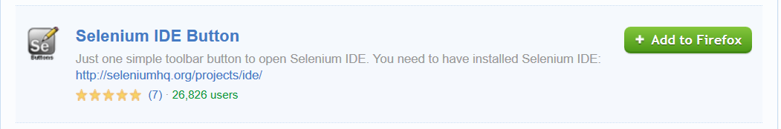
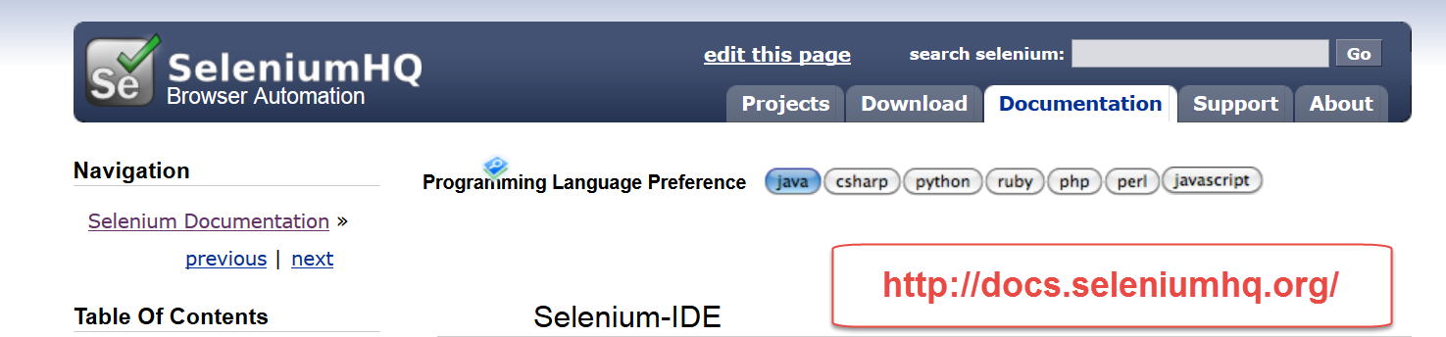
Selenium IDE
Get Firefox Addon - free
Get Selenium - free

Slide 5
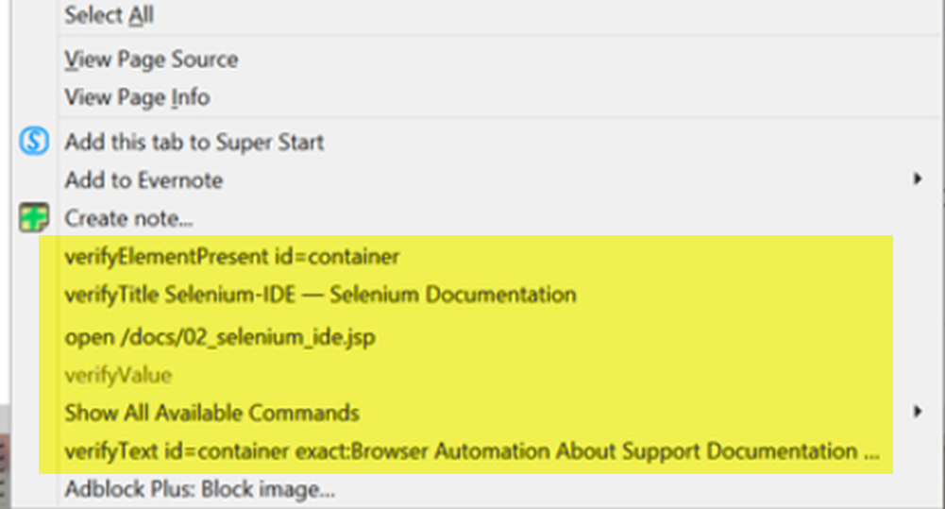
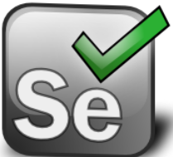
Selenium IDE
Adds right click menu items & new icon

Slide 6
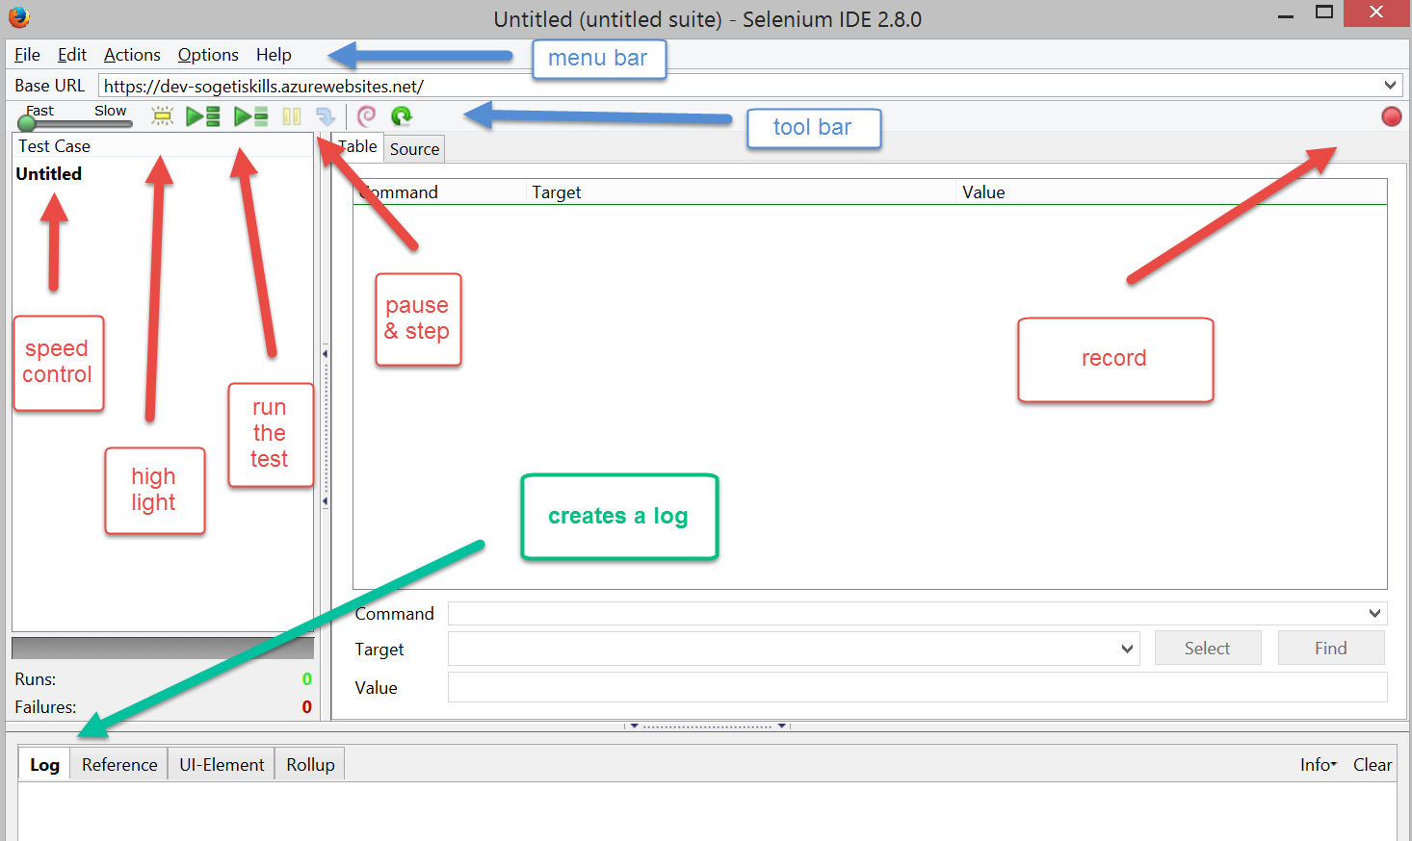
Selenium IDE
opens in a new window

Slide 7
Selenium IDE
Create (Record) a test case

Slide 8
Selenium IDE

Slide 9
Selenium IDE

Slide 10
Selenium IDE

Slide 11
Selenium IDE
TECH TALK - Selenium
Main Talking Points:
* importance of testing in software dev.
- especially agile methodologies
* advantages of automation:
repeatability,
scalability,
speed of execution,
rapid feedback, etc
* explain the different types of testing- unit, regressive, etc.
* other popular testing tools - wise to utilize multiple testing methods
* background info about Selenium, who, how and why
* main components :
-WebDriver, -Firefox plugin IDE
* basic walkthrough/introductory tutorial for Selenium
* more advanced example: set up automated regression testing to trigger from new code
* debugging & automated code analysis
(Nov. 4) The first group chose Grails (We’ll be the second of 2 groups presenting that day)

Slide 12
Selenium IDE

